Slide 2
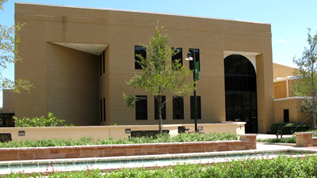
About Our Office
Where are we?
Eagle Student Services Center (ESSC)
1st floor
What hours?
8:15am-5:00pm M-F
Extended Hours: 5-7pm M-Th
9am -1pm Saturday
Or Online!
www.studentaccounting.unt.edu
Click on AskUNT for additional information
Student.Accounting@unt.edu
Reach us by Phone
940.565.3225

Slide 3
FERPA
Family Educational Rights and Privacy Act

Slide 4
What services do we offer?
ID cards for students, faculty, & staff
Process tuition and fee payments
Offer Installment Plans
Award Short-Term Loans to extend the first payment deadline
Waivers, exemptions, third-party billing
Refunds

Slide 5
Methods of Payment
Online at my.unt.edu
Accepts eChecks (online check payments) and credit/debit card payments
Credit and debit card transactions will be charged a 2.7% fee
Use the eCheck option to avoid the fee

Slide 6
Methods of Payment
Cashiering Services
Accepts checks, cash, money orders, and cashier’s checks
No debit or credit card payments at window

Slide 7
Short-Term Loan
Provides extension of the payment deadline
Available online at my.unt.edu
Loan will be applied to your student account to cover your first payment
Will include a 1% origination fee in addition to the $20 plan fee

Slide 8
The Installment Plan
Available in the fall and spring
Students enroll in the plan via my.unt.edu
Breaks up charges due into 4 payments
1st installment of 10%, plus $20 plan fee is due when you enroll
The remaining 3 payments for fall 2015 are due, October 3rd , November 3rd and December 3rd

Slide 9
Fee Payment & Financial Aid
Beginning Fall 2015, Financial Aid regulations prohibit federal financial aid from paying the following charges:
Installment plan charge, Short Term Loan Origination Fee, Memorial Loan fee, Late payment or default fees
Excess hours tuition fee
Repeat course fee
** Once federal financial aid has paid tuition, fees and housing (if applicable), some students may receive a refund yet still owe a balance because of finance and/or overtime charges. Payment arrangements would need to be made for the remaining balance to secure a student’s classes **

Slide 10
Waivers, Exemptions, and
Third Party Billing
Waivers & Exemptions
Waives or exempts (through financial assistance) a portion or all of a student’s tuition and/or fees
For questions or more information, visit www.collegeforalltexans.com
Third Party Billing
Texas Guaranteed Tuition Plan (formerly Texas Tomorrow Fund)
Texas Tuition Promise Fund
Other Sponsored billing
** The Hazlewood Act Exemption is processed by Student Veterans Services-Sage Hall Suite 123 **

Slide 11
Higher One Debit Card
UNT refunds are processed by Higher One.
After new students register for 6 or more credit hours a Higher One Debit Card will be mailed to their mailing address listed on the my.unt.edu student portal.
You need this card, but do not have to use a Higher One Account to receive their refund!
Watch for the card in your mail.

Slide 12
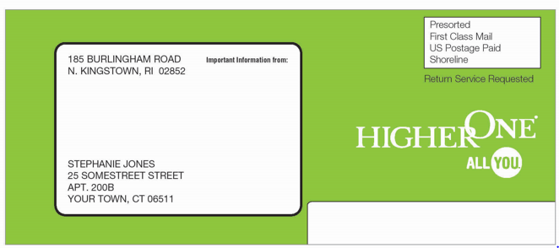
Higher One Debit Card

Slide 13
What should I do when I receive the card?
Go to untdebitcard.com to authenticate the card and select a refund preference.
Why?
Selecting a refund preference ensures that refunds are received on-time.
3 options for refund preference:
Have funds deposited to your UNT debit card and use it as a bank account.
Have funds deposited to a pre-established bank account.
Have a paper check mailed to the student.

Slide 14
Important Reminders
Check your my.unt.edu frequently
Keep your contact information up to date
If you change your schedule, after all Financial Aid has disbursed and refunded, you will have to pay any balance due
Classes will be cancelled if your balance is not paid by the payment due date
If your Financial Aid does not cover your entire bill, you may be placed on the installment plan for the upcoming semester

Slide 15
Eagle Express Tuition Plan

Slide 16
What is the Eagle Express Tuition Plan?
A fixed rate tuition plan for incoming freshmen or transfer students (Texas Residents)-
Remains active for 4 years (12 consecutive semesters that occur after the date of the student’s initial enrollment).
Locks in total academic costs until a student graduates or up to 4 years from initial enrollment in the plan, whichever comes first.
An opportunity to receive an incentive of up to $3,000 for students who complete their degrees and meet eligibility requirements.

Slide 17
Eagle Express Annual Cost
The annual cost for students electing Eagle Express beginning with Fall 2015:
$11,081.80 - 30 credit hours taken in Fall/Spring semesters
If eligible, the incentive is calculated in the student’s last 15 credit hours before graduation.

Slide 18
Transfer credits
Eligibility for the graduation incentive for students is based on the number of hours taken at UNT. The number of credits transferred to UNT determines the incentive amount and the required graduation timeframe. Students with greater than 60 transfer hours will likely not be eligible for the graduation incentive and therefore should carefully consider if the Traditional Tuition plan is the best option for them.
Transfer Credits | Eagle Express Graduation incentive amount | To qualify, student must graduate in no more than :
12 hours or fewer | $3,000 | 4 years
13-30 hours | $2,000 | 3 years
31-60 hours | $1,000 | 2 years

Slide 19
Eagle Express - How to Opt in or Out
Once you receive notification that your tuition and fee bill is available, go to my.unt.edu to view your bill. Information for electing Eagle Express will be presented.
New students are provided one opportunity to elect Eagle Express. If you do not opt-in, you will remain in the traditional tuition program for future enrollment.

Slide 20
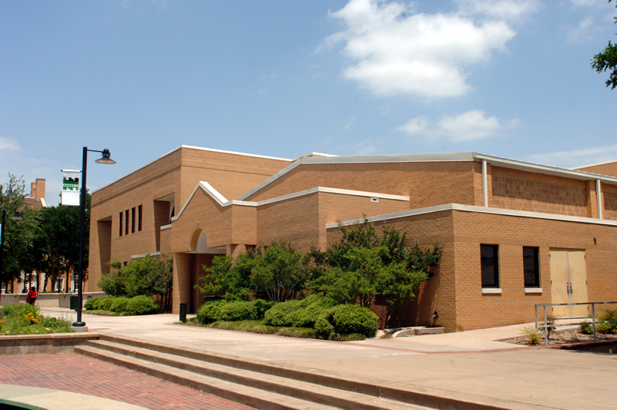
Thank you for choosing UNT!
Representatives will be available after the presentation to answer any questions you may have.

